Slide 1
Accelerometer & Camera
TMA Training Center (TTC)
Course | iPhone application development
Trainer | Thuong Tran
Designed by | TMA Mobile Solutions (TMS)
Last updated | 25 Mar 2011

Slide 2
This section objectives
Understanding about Accelerometer and Camera in iPhone Development

Slide 3
Content
Accelerometer
Accelerometer Demo
Camera
Project assignment: implementation

Slide 4
Accelerometer

Slide 5
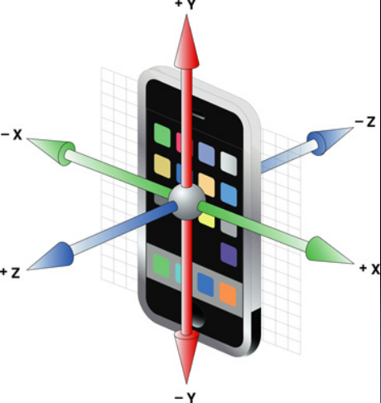
Accelerometer intro
Accelerometers are devices which measure velocity
Both iPhone and iPod touch have three accelerometers for each axis

Slide 6
Uses of Accelerometers
Apple uses it to detect whether there has been a change in orientation
  Shake to cancel/erase something
  Shake to ‘choose’eg. a dice roll
  In iPhone OS 3.0 use Motion Events
The UI has to align with how the device is positioned
  Status Bar
  Photos
  Reading
  Web Surfing
  …

Slide 7
Register for Raw Data
Part of the UIKit framework
  Remember UIKit is one of the frameworks in Cocoa Touch
We get data for the 3 dimensions
The update frequence is configurable between 10‐100Hz (see table in link)
  http://developer.apple.com/iphone/library/documentation/iPhone/Conceptual/iPhoneOSProgrammingGuide/AdvancedFeatures/AdvancedFeatures.html
The event delivery is based on delegates design pattern

Slide 8
Accelerometer Interface
The classes associated with accelerometers:
  UIAccelerometer
  UIAcceleration
Protocol for delegation:
  UIAccelerometerDelegate
You need to implement the UIAccelerometerDelegate protocol:
public myViewController: UIViewController <UIAccelerometerDelegate>

Slide 9
Configuring the Accelerometer
  ‐ (void)enableAccelerometerEvents {
  UIAccelerometer* accel = [UIAccelerometer sharedAccelerometer];
  accel.updateInterval = 1/30; // 30 Hz
  accel.delegate = self;
  }
Note as you hook into the delegate the events will start to arrive!

Slide 10
Defining your Delegate Object
‐ (void)accelerometer:(UIAccelerometer*)accelerometer
didAccelerate:(UIAcceleration*)acceleration {
// Here get the event data
UIAccelerationValue x, y, z;
x = acceleration.x;
y = acceleration.y;
z = acceleration.z;
// Now can take action based on this data
}

Slide 11
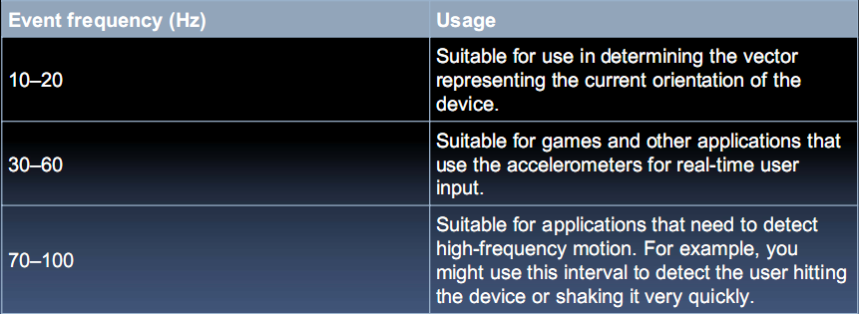
Configuring the Accelerometer
You need to choose at what rate you want to update
  The range for the system is approximately 10–100Hz
  The frequency should match your needs

Slide 12
Disabling Event Delivery
‐ (void)disableAccelerometerEvents
{
UIAccelerometer* accel = [UIAccelerometer sharedAccelerometer];
accel.delegate = nil;
}

Slide 13
Motion Events
Were introduced in iPhone OS 3.0
A simpler version of accelerometers events as the system only notifies the delegate if when the motion starts and stops and instead every single accelerometer.
Only if there is a shake is a motion event generated (currently)
The system creates a UIEvent and dispatches it

Slide 14
Motion Events
To become the first responder:
  ‐(BOOL) canBecomeFirstResponder {
  return YES;
  }
  ‐(void) viewDidAppear:(BOOL)animated{
  [self becomeFirstResponder];
  }

Slide 15
Handling Motion Event
‐(void)motionBegan:(UIEventSubtype)motion withEvent:(UIEvent *)event {
}
‐(void)motionEnded:(UIEventSubtype)motion withEvent:(UIEvent *)event {
  // Take some action such as animate/update labels…
}
‐(void)motionCancelled:(UIEventSubtype)motion withEvent:(UIEvent *)event {
}

Slide 16
Accelerometer Demo

Slide 17
Camera

Slide 18
The Image Picker Interface
• The interface provides camera capabilities
• It also provides the ability to select pictures

Slide 19
The Image Picker Interface
•The UIImagePickerController class is used as‐is (there is no subclassing)
• The class handles user/device interactions
• Your delegate needs to implement the UIImagePickerControllerDelegate protocol

Slide 20
Displaying the Image Picker
To use the image picker:
You need to check whether the source (ie. Camera) is available
Then you assign the delegate as the current class
And you present the controller in a modal fashion
  takes over the screen for a particular purpose and goes away when done

Slide 21
Displaying the Image Picker
• You call method from a view controller:
  if ([UIImagePickerController isSourceTypeAvailable:
  UIImagePickerControllerSourceTypeCamera]) {
  UIImagePickerController* myImagePicker = [[UIImagePickerContr oller alloc] init];
  myImagePicker sourceType = UIImagePickerControllerSourceTyp eCamera;
  myImagePicker.delegate = self;
  [self presentModalViewController: myImagePicker animated:YES];
  }

Slide 22
Image Picker Delegate
The UIImagePickerControllerDelegate protocol has two main methods of interest:
  •Two methods:
  ‐(void)imagePickerController:(UIImagePickerController*)picker
  didFinishPickingImage:(UIImage*)image
  editingInfo:(NSDictionary*)editingInfo;
  ‐ (void)imagePickerControllerDidCancel:
  (UIImagePickerController*)picker;

Slide 23
Image Picker Delegate
‐(void)imagePickerControllerDidCancel:(UIImagePickerController*)picker {
  // Since the user canceled the image picker, dismiss it
  [self dismissModalViewControllerAnimated:YES];
  [picker release];
}

Slide 24
Edit the Returned Image
To allow users to edit the returned image set allowsImageEditing property to YES:
This allows the user to crop the image
And the image’s metadata is returned in editingInfo
In case you want to display it, etc…

Slide 25
Editing the Returned Image
  ‐(void)imagePickerController:(UIImagePickerController*)picker
  didFinishPickingImage:(UIImage*)image
  editingInfo:(NSDictionary*)editingInfo
  {
  // The image object contains the new image on which you cansave it, etc…
  // Now you can dismiss the image picker
  [self dismissModalViewControllerAnimated:YES];
  [picker release];
  }

Slide 26
Editing the Returned Image
Note the editingInfo dictionary also contains:
  the original image in UIImagePickerControllerOriginalImage key
  the edited/cropped rectangle in UIImagePickerControllerCropRect key

